Slide 1
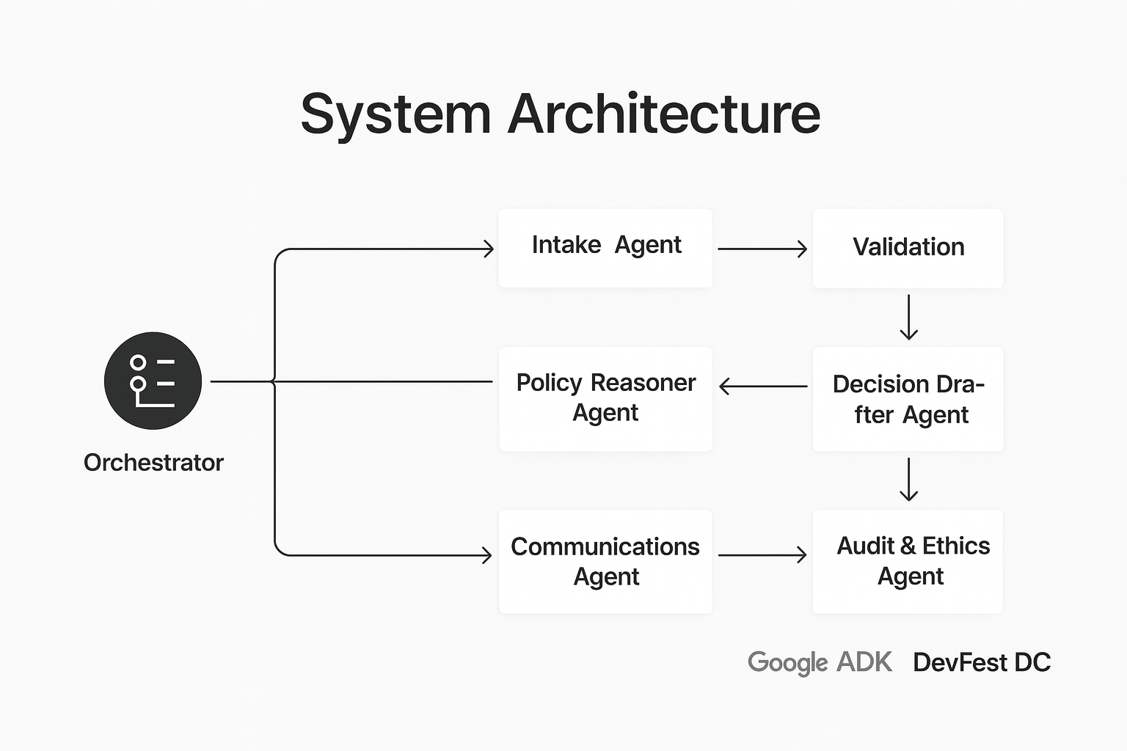
GovFlow Agent

Slide 2
Government services are slow because each request takes humans hours of triage.
GovFlow Agent automates the boring 90%, keeps humans in control, and gives citizens instant transparency.

Slide 3
The One-Line Pitch
GovFlow Agent automates a full public-service request (e.g., a small-business permit) end-to-end — from intake to validation to decision to status updates — with human-in-the-loop transparency, using Google ADK multi-agent orchestration + Gemini.

Slide 4
Problem → Demo Scenario
Use case for demo:
“Small Business Sidewalk Permit” (or “Home Renovation Permit”)

Slide 5
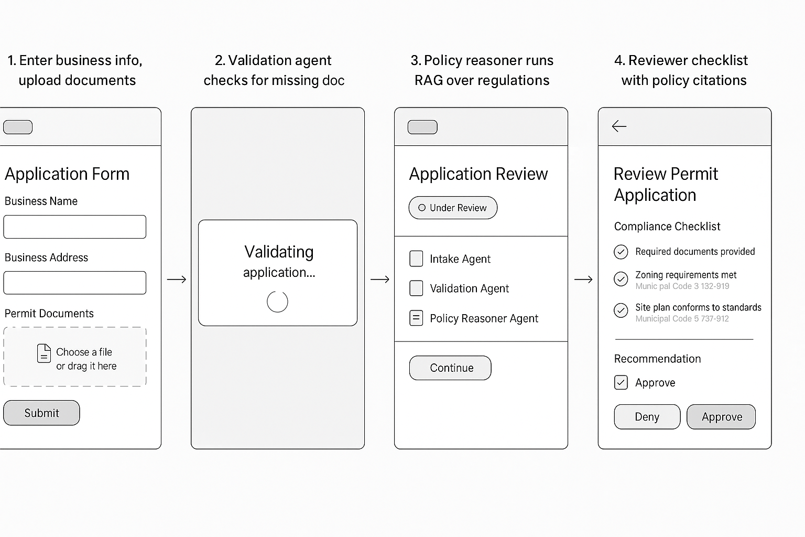
Live Demo
Notes:
Scene 1 (Citizen View)
“Here’s our applicant portal. A citizen uploads their business info and permit documents.”
(Click submit)
“The Intake Agent standardizes the form, the Validation Agent checks for missing documents, and the Policy Reasoner Agent compares it against municipal regulations in real time.”
Scene 2 (Reviewer View)
“Now, on the reviewer dashboard, we see a full checklist of policy rules with citations. The Decision Agent recommends approval, but a human still reviews and signs off.”
(Click ‘Approve’)
“The Comms Agent instantly sends the decision letter and status update to the applicant. That’s end-to-end permit approval — done in under 90 seconds.”

Slide 6
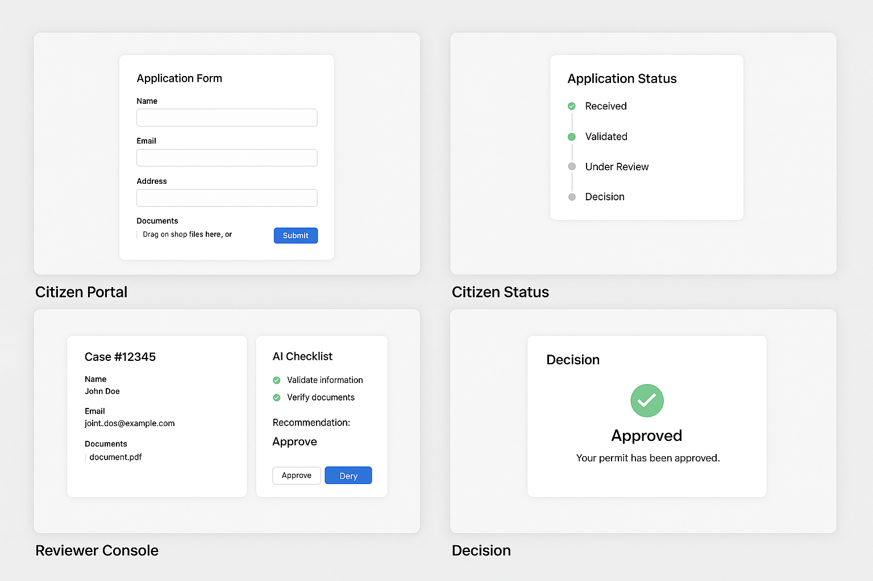
Live Demo

Slide 7
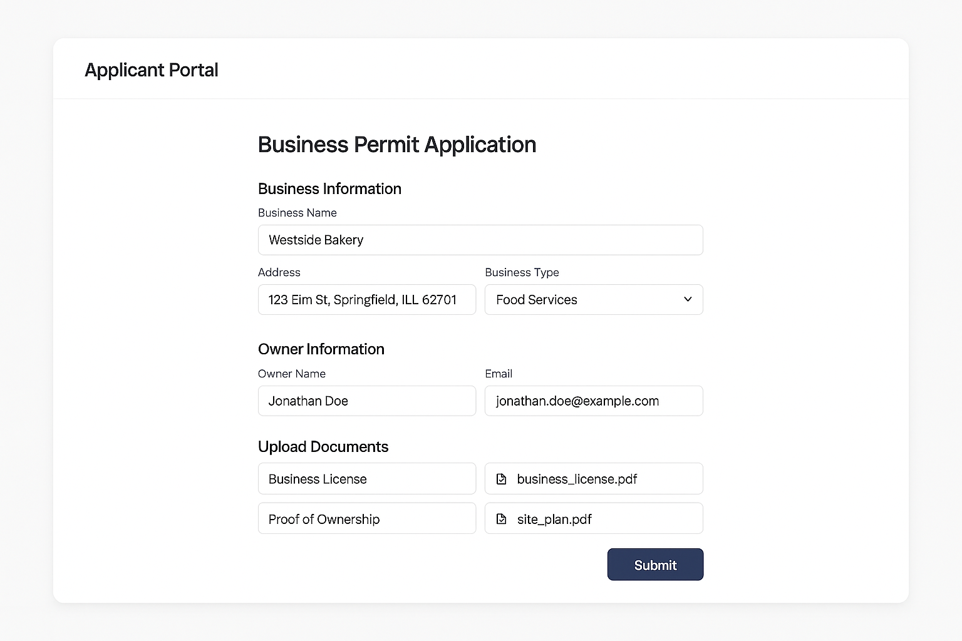
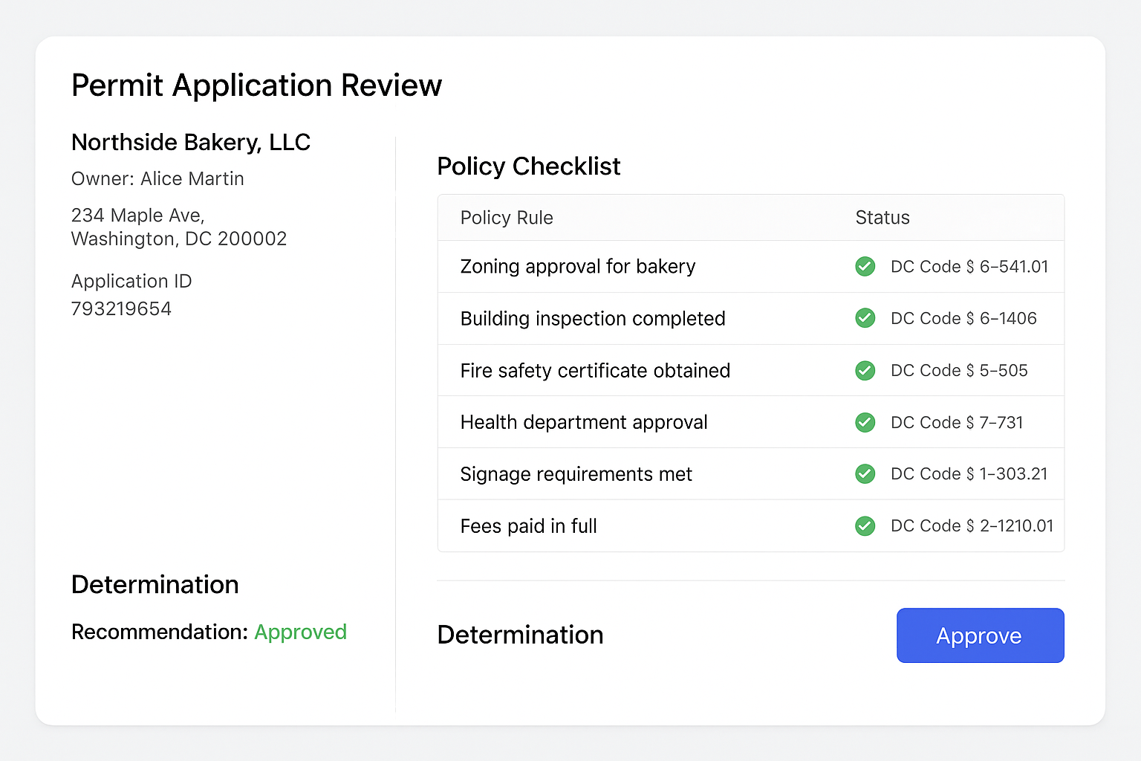
Live Demo
Citizen View
Reviewer View
Notes:
Scene 1 (Citizen View)
“Here’s our applicant portal. A citizen uploads their business info and permit documents.”
(Click submit)
“The Intake Agent standardizes the form, the Validation Agent checks for missing documents, and the Policy Reasoner Agent compares it against municipal regulations in real time.”
Scene 2 (Reviewer View)
“Now, on the reviewer dashboard, we see a full checklist of policy rules with citations. The Decision Agent recommends approval, but a human still reviews and signs off.”
(Click ‘Approve’)
“The Comms Agent instantly sends the decision letter and status update to the applicant. That’s end-to-end permit approval — done in under 90 seconds.”

Slide 8
Stress ADK orchestration + Gemini reasoning + auditability.
Notes:
Architecture diagram (agents, RAG, human-in-the-loop, audit trail).
Stress ADK orchestration + Gemini reasoning + auditability.
GovFlow is built on Google’s Agent Development Kit and Gemini — so it’s explainable, modular, and scalable. It can automate permits, FOIA requests, benefit claims — any repeatable process. Our goal is to make government services as fast, transparent, and trustworthy as the best customer experience online.

Slide 9
2) System Architecture (ADK Multi-Agent Graph)
Agents (with single responsibility):
Intake Agent — transforms form data + attachments into a canonical case object.
Validation Agent — checks presence/quality of required documents, normalizes IDs, calls mock APIs (business registry, address validation).
Policy Reasoner Agent — RAG over municipal policy PDFs; produces structured compliance checklist (pass/fail with citations).
Decision Drafter Agent — composes a recommended determination + rationale (+ uncertainty score).
Human Review Agent — routes a concise, explainable summary to a reviewer UI; accepts “Approve / Deny / Request More Info.”
Communications Agent — generates citizen-facing emails/SMS, timeline updates, and a formal decision letter (PDF).
Audit & Ethics Agent — logs chain-of-thought summaries (not raw CoT), prompts used, data sources, and fairness checks.
Orchestrator: ADK workflow that sequences the above with retry & fallback rules.
Storage & Infra (fast and simple):
Firestore (cases, status, minimal PII), Cloud Storage (uploads), Vertex AI Vector Store (policy PDFs embeddings), Pub/Sub (events), Cloud Run (web services).
Frontends: lightweight React/Next.js (citizen portal + reviewer console) or Streamlit if you want ultra-fast UI.
Notes:
Architecture diagram (agents, RAG, human-in-the-loop, audit trail).
Stress ADK orchestration + Gemini reasoning + auditability.
GovFlow is built on Google’s Agent Development Kit and Gemini — so it’s explainable, modular, and scalable. It can automate permits, FOIA requests, benefit claims — any repeatable process. Our goal is to make government services as fast, transparent, and trustworthy as the best customer experience online.

Slide 10
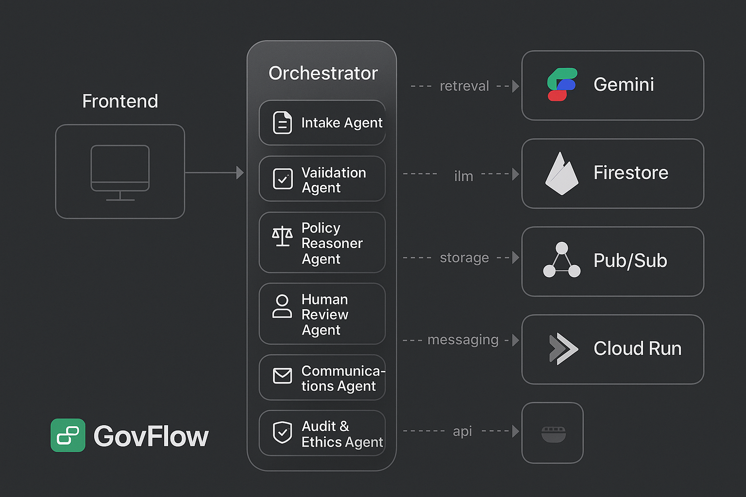

Slide 11
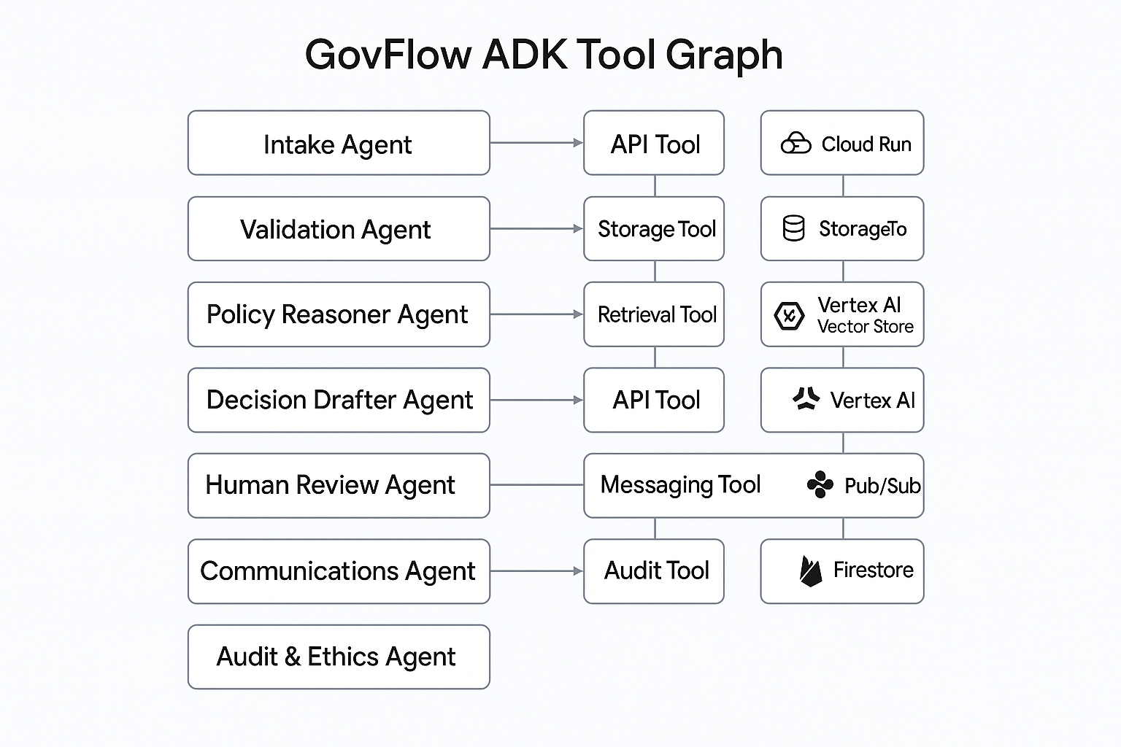

Slide 12
3) Data Flow (Happy Path)
Citizen → Web Form (JSON + files)\
Intake Agent → case:{person, address, permit_type, docs[]}
Validation Agent → checks docs; calls mock APIs; tags missing items
Policy Reasoner → queries vector store; returns checklist:[{rule, pass, citation}]
Decision Drafter → recommendation:{approve|deny|needs_info, rationale, risks}
Human Review → reviewer UI shows summary + sources + “Approve/Request info”
Communications → citizen gets status + letter (PDF)
Audit & Ethics → writes transparent log + metrics

Slide 13
4) Model & Prompting Strategy (Gemini via AI Studio)
Retrieval-Augmented Generation (RAG): Load 5–10 pages of real municipal permit PDFs (or mock policy). Chunk to 512–1k tokens.
System Prompts (tight, structured I/O):
Policy Reasoner: “Return a JSON array of rules with rule_id, requirement, evidence, pass:boolean, confidence:0–1, citation:url#section.”
Decision Drafter: “Given case, validation, checklist, produce {recommendation, rationale, risks, uncertainty} in 400 tokens max.”
Comms Agent: “Write a 6th grade–readable status + formal letter. Never expose internal prompts.”
Guardrails: refuse if PII > needed; strip SSNs; redact in logs.

Slide 14
5) Google ADK Skeleton (pseudocode)
# orchestrator.py
from adk import Agent, Orchestrator, Step, Memory
from adapters import Firestore, VertexVectorStore, CloudStorage, PubSub
from gemini import gemini_call
class IntakeAgent(Agent):
def run(self, form_payload):
case = normalize_payload(form_payload) # parse, schema-validate
case['status'] = 'RECEIVED'
return case
class ValidationAgent(Agent):
def run(self, case):
docs = fetch_docs(case['upload_ids'])
validation = check_required(docs) # presence, quality, checksum
registry = mock_business_registry(case) # simulate API lookups
return {**case, 'validation': {**validation, **registry}}
class PolicyReasonerAgent(Agent):
def run(self, case):
q = build_policy_query(case)
contexts = VertexVectorStore.search(q, k=5) # RAG
checklist = gemini_call("policy_reasoner_prompt", case=case, contexts=contexts)
return {**case, 'checklist': checklist}
class DecisionDrafterAgent(Agent):
def run(self, case):
rec = gemini_call("decision_prompt", case=case)
return {**case, 'recommendation': rec}
class HumanReviewAgent(Agent):
def run(self, case):
summary = summarize_for_reviewer(case)
decision = wait_for_reviewer_input(summary) # UI event
return {**case, 'final_decision': decision}
class CommsAgent(Agent):
def run(self, case):
letters = generate_letters(case)
send_status_updates(case['contact'], letters)
return {**case, 'status': 'COMPLETED'}
class AuditAgent(Agent):
def run(self, case):
write_audit_log(case)
return case
flow = Orchestrator(steps=[
Step(IntakeAgent),
Step(ValidationAgent, retry=1, on_fail="request_more_info"),
Step(PolicyReasonerAgent),
Step(DecisionDrafterAgent),
Step(HumanReviewAgent, hil=True),
Step(CommsAgent),
Step(AuditAgent)
])
Notes:
You can stub mock_business_registry and wait_for_reviewer_input in a day; swap with real APIs later.

Slide 15
6) UI Concepts (build the minimum lovable)
Citizen Portal (3 screens):
Start: short form (name, address, business type), file upload, consent.
Status: timeline with steps (Received → Validated → Under Review → Decision).
Decision: letter download, next steps, appeal link.
Reviewer Console (1 screen):
Left panel: case details + uploaded docs
Middle: Policy checklist with citations (green/red)
Right: AI recommendation + rationale + risks
Top: Approve / Request Info / Deny (with auto-generated message)

Slide 16
7) Metrics, Audit, & Ethics (show this to judges)
TTV (Time-to-Verdict): aim for < 2 minutes in demo
Automation Rate: % cases not needing human edits
Checklist Coverage: # rules checked vs required
Explainability Score: % checklist items with citations
Equity Guardrail: show that protected attributes are not used; log a bias check

Slide 17
8) Build Timeline (pre-work + day-of)
Before Oct 3 (4–6 hours total):
Prepare 3–5 pages of “permit policy” (real or cleaned mock) → ingest to Vertex Vector Store.
Scaffold ADK project with agents (empty run() stubs), set up Firestore/Storage.
Build quick Next.js or Streamlit UIs (form + reviewer).
Write 2–3 golden test cases (one clean approval, one missing doc, one denial).

Slide 18
8) Build Timeline (pre-work + day-of)
Hack Day (8 hours):
Wire Intake → Validation → Policy Reasoner (RAG)
Implement Decision Drafter prompt; return compact JSON
Build Reviewer Console (approve paths + “request info”)
Add Comms (email/SMS via SendGrid/Twilio or console log)
Finish Audit log (store summarized rationale + citations)
Rehearse 2-minute demo + backup flow if RAG fails

Slide 19
10) Judge Q&A — High-Ground Answers
Trust/Explainability? “Every rule check links to the exact policy section; decisions include a human-readable rationale and an audit log.”
Bias? “We strip protected attributes, log fairness checks, and support supervisor overrides with reason capture.”
Security? “We scope permissions per agent, encrypt storage, and separate PII from reasoning context.”
Scalability? “Agents are stateless, event-driven; swap mock services for real APIs without changing the flow.”
Why ADK? “Composable multi-agent pipelines + built-in patterns for planning, memory, and monitoring.”

Slide 20
11) Stretch Goals (if time allows)
Multilingual UX (auto-translate comms; Spanish at minimum).
Proactive missing-docs agent (emails citizen with a checklist and upload link).
Queue optimizer (prioritize cases near auto-approval to maximize throughput).
Analytics Dashboard (bottlenecks, average TTV, denial reasons).
Digital signature for letters; QR code for status verification.

Slide 21
12) Minimal Data & Mock Integrations
Policy corpus: 3–5 page PDF you craft (or trimmed public docs).
Mock APIs: /api/business_registry, /api/address_validate.
Emails/SMS: console logs ok for demo; swap to SendGrid/Twilio if easy.
PII: keep to name/email/address; redact everything else.

Slide 22
14) Sample Prompts (drop-in)
Policy Reasoner (system):
You evaluate municipal permit compliance.
Return STRICT JSON: [{rule_id, requirement, evidence, pass, confidence, citation}].
Use only the provided contexts[] excerpts; cite exact section IDs or page numbers.
Decision Drafter (system):
Draft a determination for a permit case using case, validation, and checklist.
Output: {recommendation: approve|deny|needs_info, rationale, risks[], uncertainty(0–1)}.
Keep under 1200 characters. Be specific and cite rule_ids.
Comms Agent (system):
Write a 6th-grade-reading-level message to the applicant describing the decision and next steps. Include a friendly tone, bullet points, and office contact.

Slide 23




Live Demo
1
2
3
4
Submit a permit request with a PDF.
Watch status move Received → Validated → Under Review.
Open Reviewer Console: show checklist with policy citations, AI rec, “Approve.”
Citizen screen updates to Approved + letter download.
Notes:
Submit a permit request with a PDF.
Watch status move Received → Validated → Under Review.
Open Reviewer Console: show checklist with policy citations, AI rec, “Approve.”
Citizen screen updates to Approved + letter download.

Slide 24

Live Demo 2
1
2
3
4
5
Citizen submits a short web form + PDF/photo of doc(s).
System auto-validates identity & required docs, checks policy rules, drafts determination.
Human reviewer gets an explainable summary + one-click approve/deny.
Citizen gets status + downloadable decision letter + next steps.
Full audit trail is stored.
Notes:
Citizen submits a short web form + PDF/photo of doc(s).
System auto-validates identity & required docs, checks policy rules, drafts determination.
Human reviewer gets an explainable summary + one-click approve/deny.
Citizen gets status + downloadable decision letter + next steps.
Full audit trail is stored.

